Slide 1
Machine Learning: Lecture 2
Concept Learning
and
Version Spaces
thanks to Brian Pardo (http://bryanpardo.com) for the illustrations on slides 17, 22, 25 and 26

Slide 2
What is a Concept? (1)
A Concept is a a subset of objects or events defined over a larger set [Example: The concept of a bird is the subset of all objects (i.e., the set of all things or all animals) that belong to the category of bird.]
Alternatively, a concept is a boolean-valued function defined over this larger set [Example: a function defined over all animals whose value is true for birds and false for every other animal].
Things
Birds
Animals
Cars

Slide 3
What is a Concept? (2)
Given X the set of all examples.
A concept C is a subset of X.
A training example T is a subset of X such that some examples of T are elements of C (the positive examples) and some examples are not elements of C (the negative examples)

Slide 4
What is Concept-Learning? (1)
Given a set of examples labeled as members or non-members of a concept, concept-learning consists of automatically inferring the general definition of this concept.
In other words, concept-learning consists of approximating a boolean-valued function from training examples of its input and output.

Slide 5
What is Concept Learning? (2)
Learning:
{<xi,yi>} ➔ ➔ f: X→ Y
with i=1..n,
xi ∈T, yi ∈ Y (={0,1})
yi= 1, if x1 is positive (∈ C)
yi= 0, if xi is negative (∉ C)
Goals of learning:
f must be such that for all xj ∈ X (not only ∈ T) - f(xj) =1 if xj ∈ C
- f(xj) = 0, if xj ∉ C
Learning
system

Slide 6
The Problem of Induction: Computer Science’s Answer
Problem: As previously noted by philosophers, the task of induction is not well formulated. In computer science the problem can be thought of as follows: there exists an infinite number of functions that satisfy the goal ➔ It is necessary to find a way to constrain the search space of f.
Definitions:
The set of all fs that satisfy the goal is called hypothesis space.
The constraints on the hypothesis space is called the inductive bias.
There are two types of inductive bias:
The hypothesis space restriction bias
The preference bias

Slide 7
Inductive Biases (1)
Hypothesis space restriction bias ➔ We restrain the language of the hypothesis space. Examples:
k-DNF: We restrict f to the set of Disjunctive Normal form formulas having an arbitrary number of disjunctions but at most, k conjunctive in each conjunctions.
K-CNF: We restrict f to the set of Conjunctive Normal Form formulas having an arbitrary number of conjunctions but with at most, k disjunctive in each disjunction.
Properties of that type of bias:
Positive: Learning will by simplified (Computationally)
Negative: The language can exclude the “good” hypothesis.

Slide 8
Inductive Biases (2)
Preference Bias: It is an order or unit of measure that serves as a base to a relation of preference in the hypothesis space.
Examples:
Occam’s razor: We prefer a simple formula for f.
Principle of minimal description length (An extension of Occam’s Razor): The best hypothesis is the one that minimise the total length of the hypothesis and the description of the exceptions to this hypothesis.

Slide 9
Using Biases for Learning (1)
How to implement learning with these bias?
Hypothesis space restriction bias:
Given:
A set S of training examples
A set of restricted hypothesis, H
Find: An hypothesis f ∈ H that minimizes the number of incorrectly classified training examples of S.

Slide 10
Using Biases for Learning (2)
Preference Bias:
Given:
A set S of training examples
An order of preference better(f1, f2) for all the hypothesis space (H) functions.
Find: the best hypothesis f ∈ H (using the “better” relation) that minimises the number of training examples S incorrectly classified.
Search techniques:
Heuristic search
Hill Climbing
Simulated Annealing et Genetic Algorithm

Slide 11
Example of a Concept Learning task
Concept: Good Days for Water Sports (values: Yes, No)
Attributes/Features:
Sky (values: Sunny, Cloudy, Rainy)
AirTemp (values: Warm, Cold)
Humidity (values: Normal, High)
Wind (values: Strong, Weak)
Water (Warm, Cool)
Forecast (values: Same, Change)
Example of a Training Point:
<Sunny, Warm, High, Strong, Warm, Same, Yes>
class

Slide 12
Example of a Concept Learning task
Database:
Day Sky AirTemp Humidity Wind Water Forecast WaterSport
1 Sunny Warm Normal Strong Warm Same Yes
2 Sunny Warm High Strong Warm Same Yes
3 Rainy Cold High Strong Warm Change No
4 Sunny Warm High Strong Cool Change Yes
class
Chosen Hypothesis Representation:
Conjunction of constraints on each attribute where:
“?” means “any value is acceptable”
“0” means “no value is acceptable”
Example of a hypothesis: <?,Cold,High,?,?,?>
(If the air temperature is cold and the humidity high then
it is a good day for water sports)

Slide 13
Example of a Concept Learning task
Goal: To infer the “best” concept-description from the set of all possible hypotheses (“best” means “which best generalizes to all (known or unknown) elements of the instance space”. . concept-learning is an ill-defined task)
Most General Hypothesis: Everyday is a good day for water sports <?,?,?,?,?,?>
Most Specific Hypothesis: No day is a good day for water sports <0,0,0,0,0,0>

Slide 14
Terminology and Notation
The set of items over which the concept is defined is called the set of instances (denoted by X)
The concept to be learned is called the Target Concept (denoted by c: X--> {0,1})
The set of Training Examples is a set of instances, x, along with their target concept value c(x).
Members of the concept (instances for which c(x)=1) are called positive examples.
Nonmembers of the concept (instances for which c(x)=0) are called negative examples.
H represents the set of all possible hypotheses. H is determined by the human designer’s choice of a hypothesis representation.
The goal of concept-learning is to find a hypothesis h:X --> {0,1} such that h(x)=c(x) for all x in X.

Slide 15
Concept Learning as Search
Concept Learning can be viewed as the task of searching through a large space of hypotheses implicitly defined by the hypothesis representation.
Selecting a Hypothesis Representation is an important step since it restricts (or biases) the space that can be searched. [For example, the hypothesis “If the air temperature is cold or the humidity high then it is a good day for water sports” cannot be expressed in our chosen representation.]

Slide 16
General to Specific Ordering of Hypotheses I
Definition: Let hj and hk be boolean-valued functions defined over X. Then hj is more-general-than-or-equal-to hk iff For all x in X, [(hk(x) = 1) --> (hj(x)=1)]
Example:
h1 = <Sunny,?,?,Strong,?,?>
h2 = <Sunny,?,?,?,?,?>
Every instance that are classified as positive by h1 will also be classified as positive by h2 in our example data set. Therefore h2 is more general than h1.

Slide 17
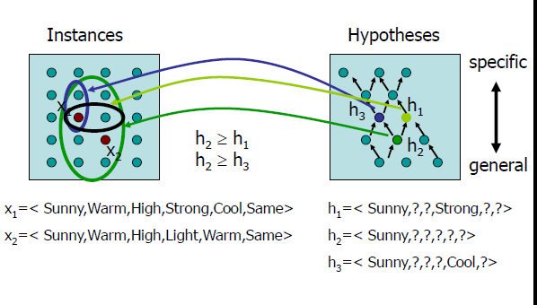
General to Specific Ordering of Hypotheses II
from Bryan Pardo, EECS 349, Machine Learning, Fall 2009

Slide 18
Find-S, a Maximally Specific Hypothesis Learning Algorithm
Initialize h to the most specific hypothesis in H
For each positive training instance x
For each attribute constraint ai in h
If the constraint ai is satisfied by x
then do nothing
else replace ai in h by the next more general constraint that is satisfied by x
Output hypothesis h

Slide 19
Shortcomings of Find-S
Although Find-S finds a hypothesis consistent with the training data, it does not indicate whether that is the only one available
Is it a good strategy to prefer the most specific hypothesis?
What if the training set is inconsistent (noisy)?
What if there are several maximally specific consistent hypotheses? Find-S cannot backtrack!

Slide 20
Version Spaces and the Candidate-Elimination Algorithm
Definition: A hypothesis h is consistent with a set of training examples D iff h(x) = c(x) for each example <x,c(x)> in D.
Definition: The version space, denoted VS_H,D, with respect to hypothesis space H and training examples D, is the subset of hypotheses from H consistent with the training examples in D.
NB: While a Version Space can be exhaustively enumerated, a more compact representation is preferred.

Slide 21
A Compact Representation for Version Spaces
Instead of enumerating all the hypotheses consistent with a training set, we can represent its most specific and most general boundaries. The hypotheses included in-between these two boundaries can be generated as needed.
Definition: The general boundary G, with respect to hypothesis space H and training data D, is the set of maximally general members of H consistent with D.
Definition: The specific boundary S, with respect to hypothesis space H and training data D, is the set of minimally general (i.e., maximally specific) members of H consistent with D.

Slide 22
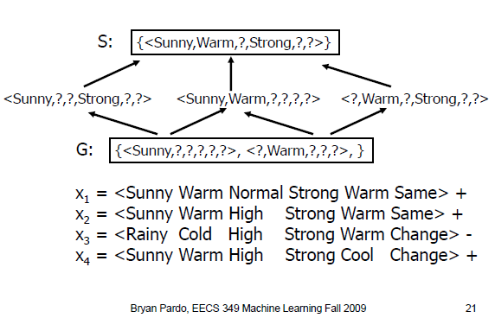
A Compact Representation for Version Spaces: An example

Slide 23
Version Spaces: Definitions
Given C1 and C2, two concepts represented by sets of examples. If C1 ⊂ C2, then C1 is a specialisation of C2 and C2 is a generalisation of C1.
C1 is also considered more specific than C2
Example: The set off all blue triangles is more specific than the set of all the triangles.
C1 is an immediate specialisation of C2 if there is no concept that are a specialisation of C2 and a generalisation of C1.
A version space define a graph where the nodes are concepts and the arcs specify that a concept is an immediate specialisation of another one.

Slide 24
Candidate-Elimination Learning Algorithm
The candidate-Elimination algorithm computes the version space containing all (and only those) hypotheses from H that are consistent with an observed sequence of training examples.

Slide 25
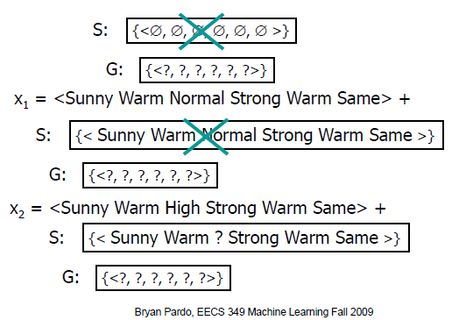
Version Space Example

Slide 26
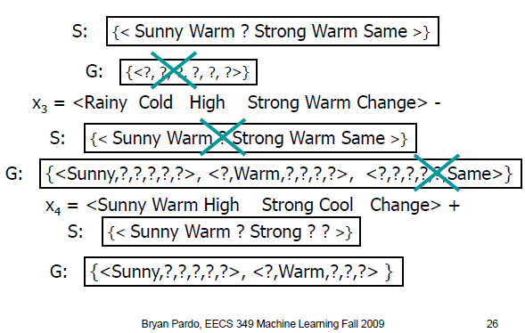
Version Space Example (cont’d)

Slide 27
Remarks on Version Spaces and Candidate-Elimination
The version space learned by the Candidate-Elimination Algorithm will converge toward the hypothesis that correctly describes the target concept provided: (1) There are no errors in the training examples; (2) There is some hypothesis in H that correctly describes the target concept.
Convergence can be speeded up by presenting the data in a strategic order. The best examples are those that satisfy exactly half of the hypotheses in the current version space.
Version-Spaces can be used to assign certainty scores to the classification of new examples

Slide 28
Inductive Bias I: A Biased Hypothesis Space
Database:
Day Sky AirTemp Humidity Wind Water Forecast WaterSport
1 Sunny Warm Normal Strong Cool Change Yes
2 Cloudy Warm Normal Strong Cool Change Yes
3 Rainy Warm Normal Strong Cool Change No
Given our previous choice of the hypothesis space representation, no hypothesis is consistent with the above database: we have BIASED the learner to consider only conjunctive hypotheses
class

Slide 29
Inductive Bias II: An Unbiased Learner
In order to solve the problem caused by the bias of the hypothesis space, we can remove this bias and allow the hypotheses to represent every possible subset of instances. The previous database could then be expressed as: <Sunny, ?,?,?,?,?> v <Cloudy,?,?,?,?,?,?>
However, such an unbiased learner is not able to generalize beyond the observed examples!!!! All the non-observed examples will be well-classified by half the hypotheses of the version space and misclassified by the other half.

Slide 30
Inductive Bias III: The Futility of Bias-Free Learning
Fundamental Property of Inductive Learning A learner that makes no a priori assumptions regarding the identity of the target concept has no rational basis for classifying any unseen instances.
We constantly have recourse to inductive biases Example: we all know that the sun will rise tomorrow. Although we cannot deduce that it will do so based on the fact that it rose today, yesterday, the day before, etc. (see the philosophical basis of induction) , we do take this leap of faith or use this inductive bias, naturally!

Slide 31
Inductive Bias IV: A Definition
Consider a concept-learning algorithm L for the set of instances X. Let c be an arbitrary concept defined over X, and let Dc = {<x,c(x)>} be an arbitrary set of training examples of c. Let L(xi,Dc) denote the classification assigned to the instance xi by L after training on the data Dc. The inductive bias of L is any minimal set of assertions B such that for any target concept c and corresponding training examples Dc
(For all xi in X) [(B ^Dc^xi) |-- L(xi,Dc)]

Slide 32
Ranking Inductive Learners according to their Biases
Weak
Rote-Learner: This system simply memorizes the training data and their classification--- No generalization is involved.
Candidate-Elimination: New instances are classified only if all the hypotheses in the version space agree on the classification
Find-S: New instances are classified using the most specific hypothesis consistent with the training data
Bias
Strength
Strong

